Slide 1
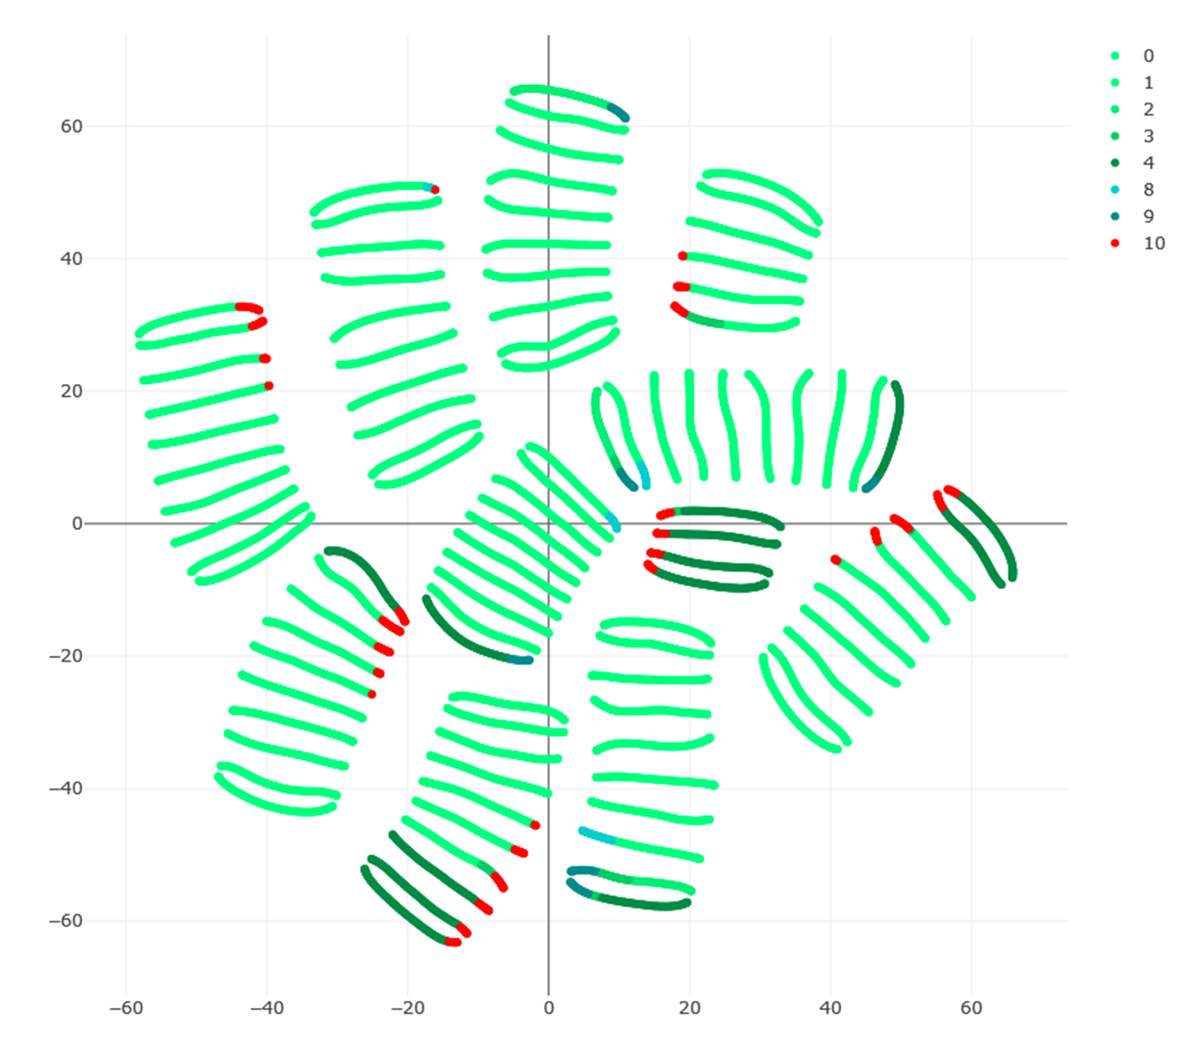
= no production
= 1 production
= 2 production
= 3 production
= 4 production
= 3 production + spare part order
= 4 production + spare part order
= maintenance
Proximal Policy Optimization

Slide 2
Open “tsne.html” for interactive tSNE plot
Start with one of the circled clusters:

Slide 3
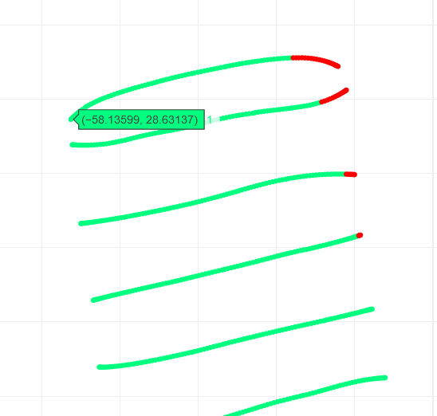
Mouseover over one of multiple representative points (example marked with x). I suggest you use minimum 4 points (top-left, top-right, bottom-left, bottom-right), but it can be more.
X
X
X
X
X
X
X
X
X
Get the x (tSNE1) and y (tSNE2) coordinates from the interactive html plot:
tSNE1 = -58.13599
tSNE2 = 28.63137

Slide 4
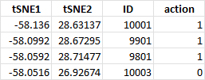
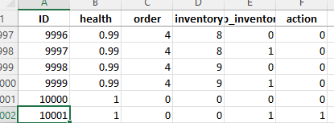
Open “PPO_ID_lookup_data.xlsx” and look for entry with corresponding coordinates and find the ID:
ID = 10001
Open “PPO_raw_data.xlsx” and find the entry with the same ID and document the values for health, order, inventory, and sp_inventory (spare parts):

Slide 5
Repeat steps 3) to 6) until you can characterize ONE entire cluster using the representative values from step 6, e.g., like this:
Documentation
-> Top-left
-> Top-right
-> Bottom-left
-> Bottom-right
Health = [0, 1]
Final Characterization
inventory = [0, 9]
sp_inventory = 1, order=0
Repeat steps 2) to 7) until you can characterize ALL clusters

